Slide 1
Phase-field multiphysics simulation with the
User Element (UEL) subroutine in Abaqus/Standard
Nguyen Xuan Binh, Junhe Lian*
Aalto University, Finland
Corresponding author: junhe.lian@aalto.fi

Slide 2
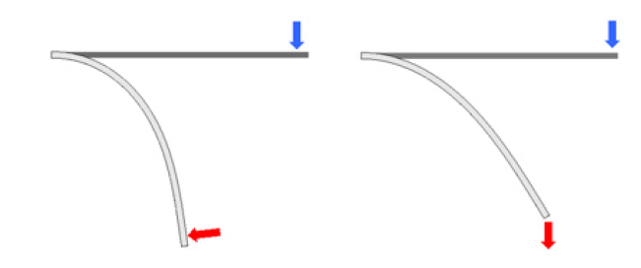
Table of Contents
Assembly of Abaqus/Standard subroutines
The UEL subroutine
Documentation websites
FEM formulation for C3D8/C3D8T element
Solving mechanical field
Linear geometry and nonlinear geometry
Solving heat transfer and hydrogen diffusion field
Solving phase field damage field
Step-by-step preprocessing for UEL subroutine
Parallelization and thread safety
Example on the 3D elastic central hole plate
Example on the 3D elastic notched plate
Nonlinear geometry
Linear geometry

Slide 3
Note:
This PPT contains advanced FEM theory and deep understanding of how Abaqus solvers work
It mainly serves as documentations for anyone who wishes to understand and use the UEL subroutine

Slide 4
Assembly of
Abaqus/Standard subroutines

Slide 5
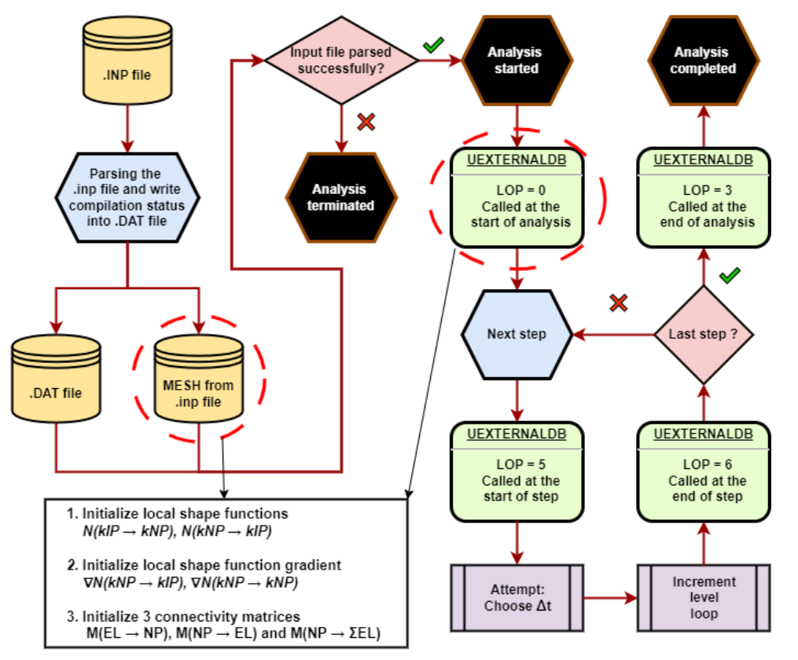
What is a slip model?

Slide 6
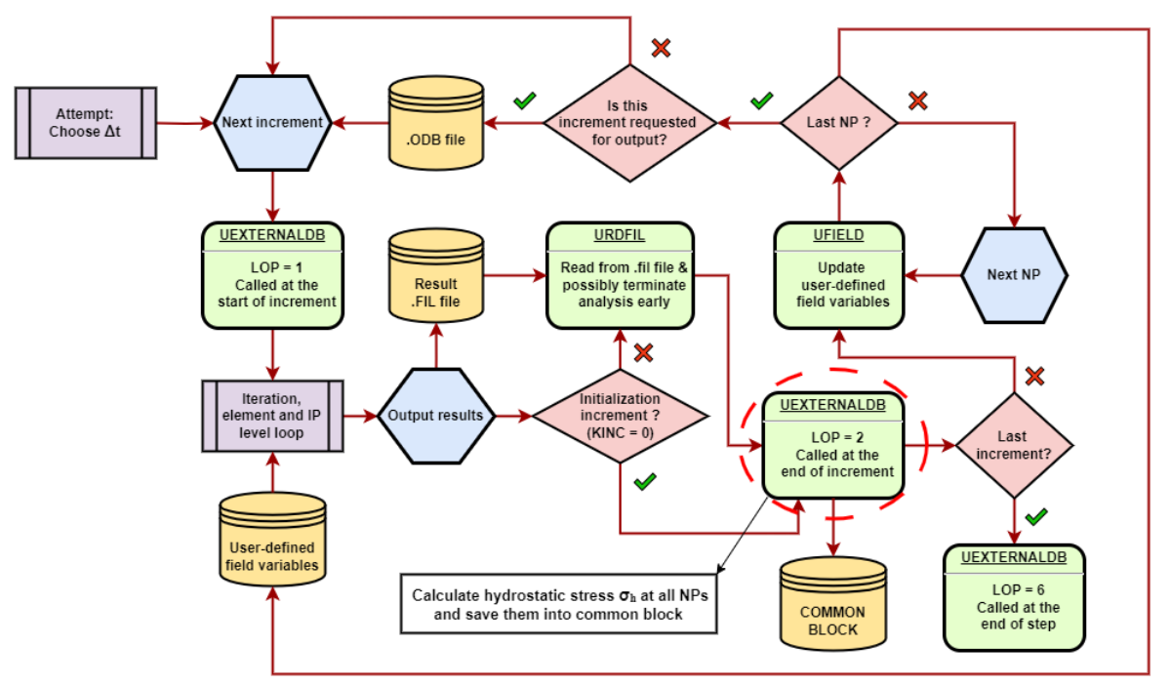

Slide 7
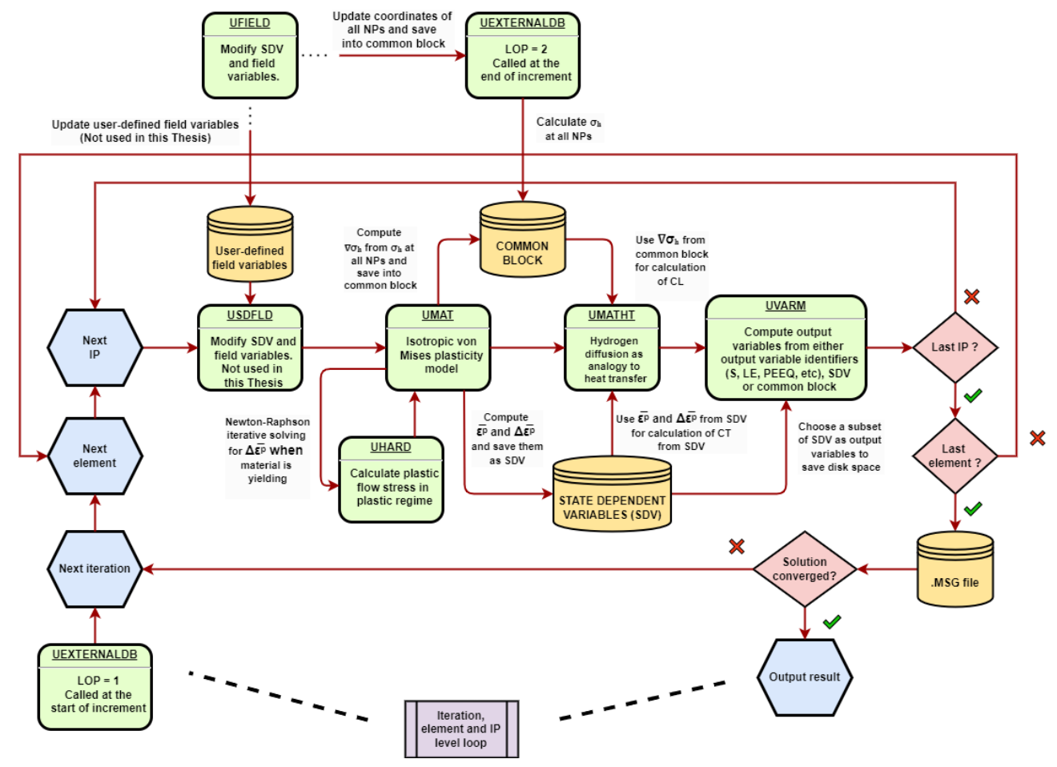

Slide 8
The UEL subroutine

Slide 12
Documentation websites

Slide 13
Important official Abaqus documentations
*PHYSICAL CONSTANTS - SIMULIA User Assistance 2025
UMAT - SIMULIA User Assistance 2025
UMATHT - SIMULIA User Assistance 2024
UEL - SIMULIA User Assistance 2025
HETVAL - SIMULIA User Assistance 2025
Uncoupled Heat Transfer Analysis - SIMULIA User Assistance 2025
Fully Coupled Thermal-Stress Analysis - SIMULIA User Assistance 2025
User-Defined Elements - SIMULIA User Assistance 2025
Conventions - SIMULIA User Assistance 2025
Initial Condition Types - SIMULIA User Assistance 2025
Solid isoparametric quadrilaterals and hexahedra - SIMULIA User Assistance 2025

Slide 14
Fem formulation for C3D8 element

Slide 15
Indenter – Analytic or Discrete Grid?

Slide 16
Indenter – Analytic or Discrete Grid?

Slide 17
Solving mechanical (deformation) field

Slide 18
Indenter – Analytic or Discrete Grid?

Slide 19
Indenter – Analytic or Discrete Grid?

Slide 20
Indenter – Analytic or Discrete Grid?

Slide 21
Indenter – Analytic or Discrete Grid?

Slide 22
Linear geometry and nonlinear geometry

Slide 23
Indenter – Analytic or Discrete Grid?

Slide 24
Indenter – Analytic or Discrete Grid?

Slide 25
Indenter – Analytic or Discrete Grid?

Slide 26
Indenter – Analytic or Discrete Grid?

Slide 27
Indenter – Analytic or Discrete Grid?

Slide 28
Solving heat transfer and hydrogen diffusion field

Slide 29
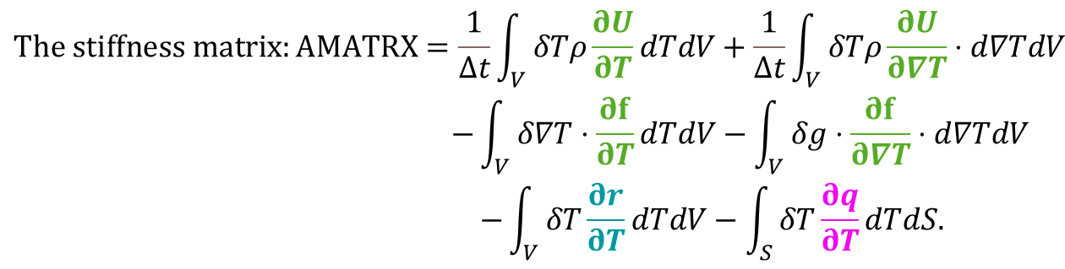
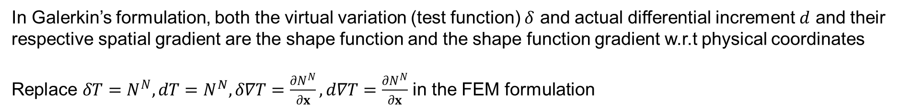
Transient heat transfer discretized equations for weak form
Solve $AMATRX$ ${\overline{c}}^{N}$= $RHS$ $with T_{t+Δt,i+1}^{N}=T_{t+Δt,i}^{N}+{\overline{c}}^{N},with i= \text{iteration} \text{number}$ from increment $t$ to $t+Δt$
$$\begin{aligned}The stiffness matrix:AMATRX=\frac{1}{Δt}\int_{V}{ }δTρ\frac{∂U}{∂T}dTdV&+\frac{1}{Δt}\int_{V}{ }δTρ\frac{∂U}{∂∇T}⋅d∇TdV \\ −\int_{V}{ }δ∇T⋅\frac{∂f}{∂T}dTdV−\int_{V}{ }δg⋅\frac{∂f}{∂∇T}⋅d∇TdV \\ −\int_{V}{ }δT\frac{∂r}{∂T}dTdV−\int_{S}{ }δT\frac{∂q}{∂T}dTdS.\end{aligned}$$
Dirichlet BC – from UMATHT subroutine
Dirichlet BC – from HETVAL subroutine
Neumann BC – from DFLUX subroutine
$$The residual right hand side: RHS=\int_{V}{ }δg⋅fdV+\int_{V}{ }δTrdV+\int_{S}{ }δTqdS−\frac{1}{Δt}\int_{V}{ }δTρ\left(U_{t+Δt}−U_{t}\right)dV$$
In Galerkin’s formulation, both the virtual variation (test function) $δ$ and actual differential increment $d$ and their respective spatial gradient are the shape function and the shape function gradient w.r.t physical coordinates
Replace $δT=N^{N}, dT=N^{N},δ∇T=\frac{∂N^{N}}{∂x},d∇T=\frac{∂N^{N}}{∂x}$ in the FEM formulation

Slide 30
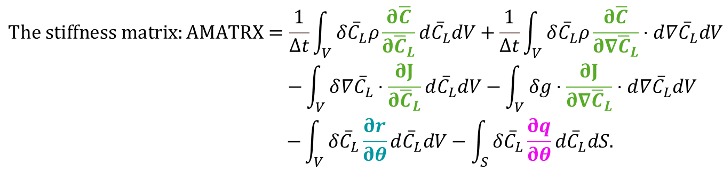

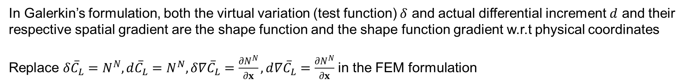
Transient hydrogen diffusion discretized equations for weak form
Solve $AMATRX$ ${\overline{c}}^{N}$= $RHS$ $with {{\overline{C}}_{L}}_{t+Δt,i+1}^{N}={{\overline{C}}_{L}}_{t+Δt,i}^{N}+{\overline{c}}^{N},with i= \text{iteration} \text{number}$ from increment $t$ to $t+Δt$
In mass transport, we have $ρ=1$
Dirichlet BC – from UMATHT subroutine
$$\begin{aligned}The stiffness matrix:AMATRX=\frac{1}{Δt}\int_{V}{ }δ{\overline{C}}_{L}ρ\frac{∂\overline{C}}{∂{\overline{C}}_{L}}d{\overline{C}}_{L}dV&+\frac{1}{Δt}\int_{V}{ }δ{\overline{C}}_{L}ρ\frac{∂\overline{C}}{∂∇{\overline{C}}_{L}}⋅d{∇\overline{C}}_{L}dV \\ −\int_{V}{ }δ{∇\overline{C}}_{L}⋅\frac{∂J}{∂{\overline{C}}_{L}}d{\overline{C}}_{L}dV−\int_{V}{ }δg⋅\frac{∂J}{∂∇{\overline{C}}_{L}}⋅d{∇\overline{C}}_{L}dV \\ −\int_{V}{ }δ{\overline{C}}_{L}\frac{∂r}{∂θ}d{\overline{C}}_{L}dV−\int_{S}{ }δ{\overline{C}}_{L}\frac{∂q}{∂θ}d{\overline{C}}_{L}dS.\end{aligned}$$
Dirichlet BC – from HETVAL subroutine
Neumann BC – from DFLUX subroutine
$$The residual right hand side: RHS=\int_{V}{ }δ{∇\overline{C}}_{L}⋅JdV+\int_{V}{ }δ{\overline{C}}_{L}rdV+\int_{S}{ }δ{\overline{C}}_{L}qdS−\frac{1}{Δt}\int_{V}{ }δ{\overline{C}}_{L}ρ\left({\overline{C}}_{t+Δt}−{\overline{C}}_{t}\right)dV$$
In Galerkin’s formulation, both the virtual variation (test function) $δ$ and actual differential increment $d$ and their respective spatial gradient are the shape function and the shape function gradient w.r.t physical coordinates
Replace $δ{\overline{C}}_{L}=N^{N}, d{\overline{C}}_{L}=N^{N},δ{∇\overline{C}}_{L}=\frac{∂N^{N}}{∂x},d{∇\overline{C}}_{L}=\frac{∂N^{N}}{∂x}$ in the FEM formulation

Slide 31
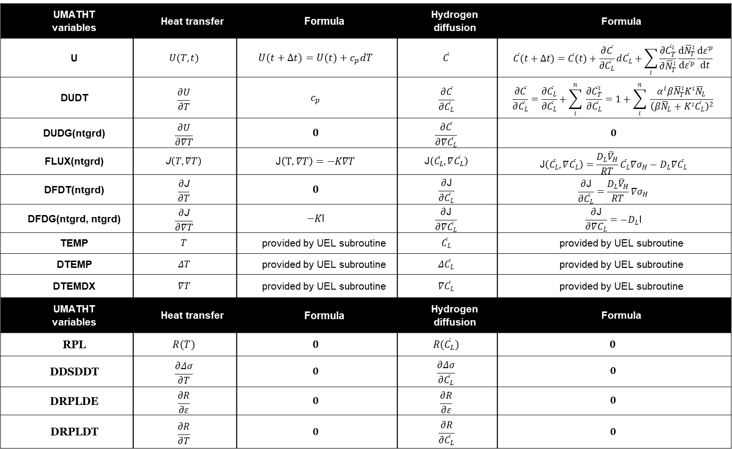
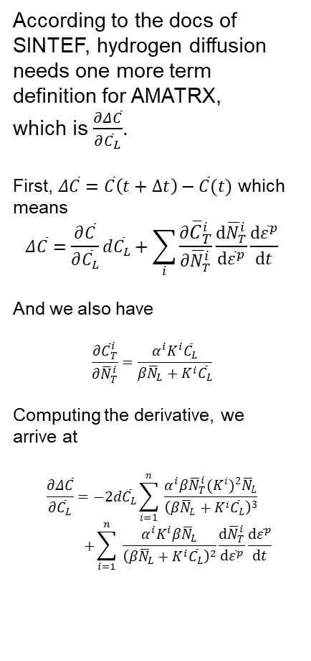
Heat transfer and Hydrogen diffusion term definitions
UMATHT variables | Heat transfer | Formula | Hydrogen diffusion | Formula
U | $$U(T,t)$$ | $$U(t+Δt)=U(t)+c_{p}dT$$ | $$\overline{C}$$ | $$\overline{C}(t+Δt)=\overline{C}(t)+\frac{∂\overline{C}}{∂{\overline{C}}_{L}}d{\overline{C}}_{L}+\sum_{i}{\frac{∂{\overline{C}}_{T}^{i}}{∂{\overline{N}}_{T}^{i}}\frac{d{\overline{N}}_{T}^{i}}{d{\overline{ε}}^{p}}\frac{d{\overline{ε}}^{p}}{dt}}$$
DUDT | $$\frac{∂U}{∂T}$$ | $$c_{p}$$ | $$\frac{∂\overline{C}}{∂{\overline{C}}_{L}}$$ | $$\frac{∂\overline{C}}{∂{\overline{C}}_{L}}=\frac{∂{\overline{C}}_{L}}{∂{\overline{C}}_{L}}+\sum_{i}^{n}{ }\frac{∂{\overline{C}}_{T}^{i}}{∂{\overline{C}}_{L}}=1+\sum_{i}^{n}{ }\frac{α^{i}β{\overline{N}}_{T}^{i}K^{i}{\overline{N}}_{L}}{{\left(β{\overline{N}}_{L}+K^{i}{\overline{C}}_{L}\right)}^{2}}$$
DUDG(ntgrd) | $$\frac{∂U}{∂∇T}$$ | $$0$$ | $$\frac{∂\overline{C}}{∂∇{\overline{C}}_{L}}$$ | $$0$$
FLUX(ntgrd) | $$\text{J}\left(T,∇T\right)$$ | $$\text{J}\left(T,∇T\right)=−K∇T$$ | $$\text{J}\left({\overline{C}}_{L},∇{\overline{C}}_{L}\right)$$ | $$\text{J}\left({\overline{C}}_{L},∇{\overline{C}}_{L}\right)=\frac{D_{L}{\overline{V}}_{H}}{RT}{\overline{C}}_{L}∇σ_{H}−D_{L}∇{\overline{C}}_{L}$$
DFDT(ntgrd) | $$\frac{∂\text{J}}{∂T}$$ | $$0$$ | $$\frac{∂\text{J}}{∂{\overline{C}}_{L}}$$ | $$\frac{∂\text{J}}{∂{\overline{C}}_{L}}=\frac{D_{L}{\overline{V}}_{H}}{RT}∇σ_{H}$$
DFDG(ntgrd, ntgrd) | $$\frac{∂\text{J}}{∂∇T}$$ | $$−K\text{I}$$ | $$\frac{∂\text{J}}{∂∇{\overline{C}}_{L}}$$ | $$\frac{∂\text{J}}{∂∇C_{L}}=−D_{L}\text{I}$$
TEMP | $$T$$ | provided by UEL subroutine | $${\overline{C}}_{L}$$ | provided by UEL subroutine
DTEMP | $$ΔT$$ | provided by UEL subroutine | $$Δ{\overline{C}}_{L}$$ | provided by UEL subroutine
DTEMDX | $$∇T$$ | provided by UEL subroutine | $$∇{\overline{C}}_{L}$$ | provided by UEL subroutine
UMATHT variables | Heat transfer | Formula | Hydrogen diffusion | Formula
RPL | $$R(T)$$ | $$0$$ | $$R({\overline{C}}_{L})$$ | $$0$$
DDSDDT | $$\frac{∂Δσ}{∂T}$$ | $$0$$ | $$\frac{∂Δσ}{∂{\overline{C}}_{L}}$$ | $$0$$
DRPLDE | $$\frac{∂R}{∂ε}$$ | $$0$$ | $$\frac{∂R}{∂ε}$$ | $$0$$
DRPLDT | $$\frac{∂R}{∂T}$$ | $$0$$ | $$\frac{∂R}{∂{\overline{C}}_{L}}$$ | $$0$$
According to the docs of SINTEF, hydrogen diffusion needs one more term definition for AMATRX,
which is $\frac{∂Δ\overline{C}}{∂{\overline{C}}_{L}}$.
First, $Δ\overline{C}=\overline{C}\left(t+Δt\right)−\overline{C}(t)$ which means
$$Δ\overline{C}=\frac{∂\overline{C}}{∂{\overline{C}}_{L}}d{\overline{C}}_{L}+\sum_{i}{\frac{∂{\overline{C}}_{T}^{i}}{∂{\overline{N}}_{T}^{i}}\frac{d{\overline{N}}_{T}^{i}}{d{\overline{ε}}^{p}}\frac{d{\overline{ε}}^{p}}{dt}}$$
And we also have
$$\frac{∂{\overline{C}}_{T}^{i}}{∂{\overline{N}}_{T}^{i}}=\frac{{α^{i}K}^{i}{\overline{C}}_{L}}{β{\overline{N}}_{L}+K^{i}{\overline{C}}_{L}}$$
Computing the derivative, we arrive at
$$\frac{∂Δ\overline{C}}{∂{\overline{C}}_{L}}=−2d{\overline{C}}_{L}\sum_{i=1}^{n}{ }\frac{α^{i}β{\overline{N}}_{T}^{i}(K^{i})^{2}{\overline{N}}_{L}}{{\left(β{\overline{N}}_{L}+K^{i}{\overline{C}}_{L}\right)}^{3}}$$
$$+\sum_{i=1}^{n}{ }\frac{α^{i}K^{i}β{\overline{N}}_{L}}{{\left(β{\overline{N}}_{L}+K^{i}{\overline{C}}_{L}\right)}^{2}}\frac{d{\overline{N}}_{T}^{i}}{d{\overline{ε}}^{p}}\frac{d{\overline{ε}}^{p}}{dt}$$
https://www.sintef.no/en/publications/publication/1650299/

Slide 32
Indenter – Analytic or Discrete Grid?

Slide 33
Indenter – Analytic or Discrete Grid?

Slide 34
Indenter – Analytic or Discrete Grid?

Slide 35
Solving damage phase field

Slide 36
Indenter – Analytic or Discrete Grid?

Slide 37
Indenter – Analytic or Discrete Grid?

Slide 38
Indenter – Analytic or Discrete Grid?

Slide 39
Step-by-step preprocessing for UEL subroutine

Slide 40
Indenter – Analytic or Discrete Grid?

Slide 41
Indenter – Analytic or Discrete Grid?

Slide 42
Indenter – Analytic or Discrete Grid?

Slide 43
Indenter – Analytic or Discrete Grid?

Slide 44
Step-by-step preprocessing for UEL subroutine

Slide 45
Indenter – Analytic or Discrete Grid?

Slide 46
Indenter – Analytic or Discrete Grid?

Slide 47

Nguyen Xuan Binh, Junhe Lian*
Aalto University, Finland
Corresponding author: junhe.lian@aalto.fi

